Slide 1
Car Sales Application
By
Aayush Gour

Slide 2



Tech Stack
ReactJS
Recharts
React Icons
Redux
NodeJS
Express
pg - postgres
Postgres
Front-end
Back-end
Database

Slide 3
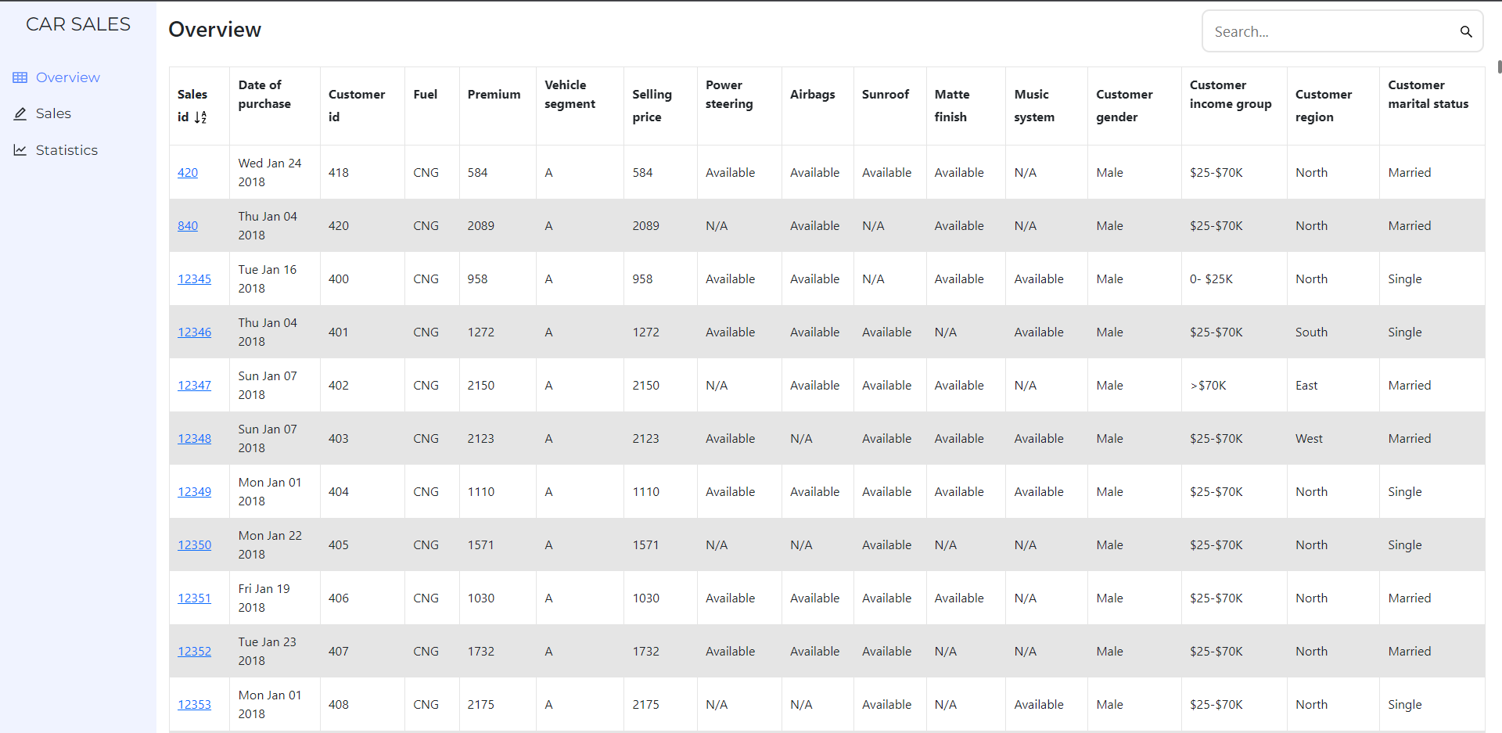
Screenshots

Slide 4
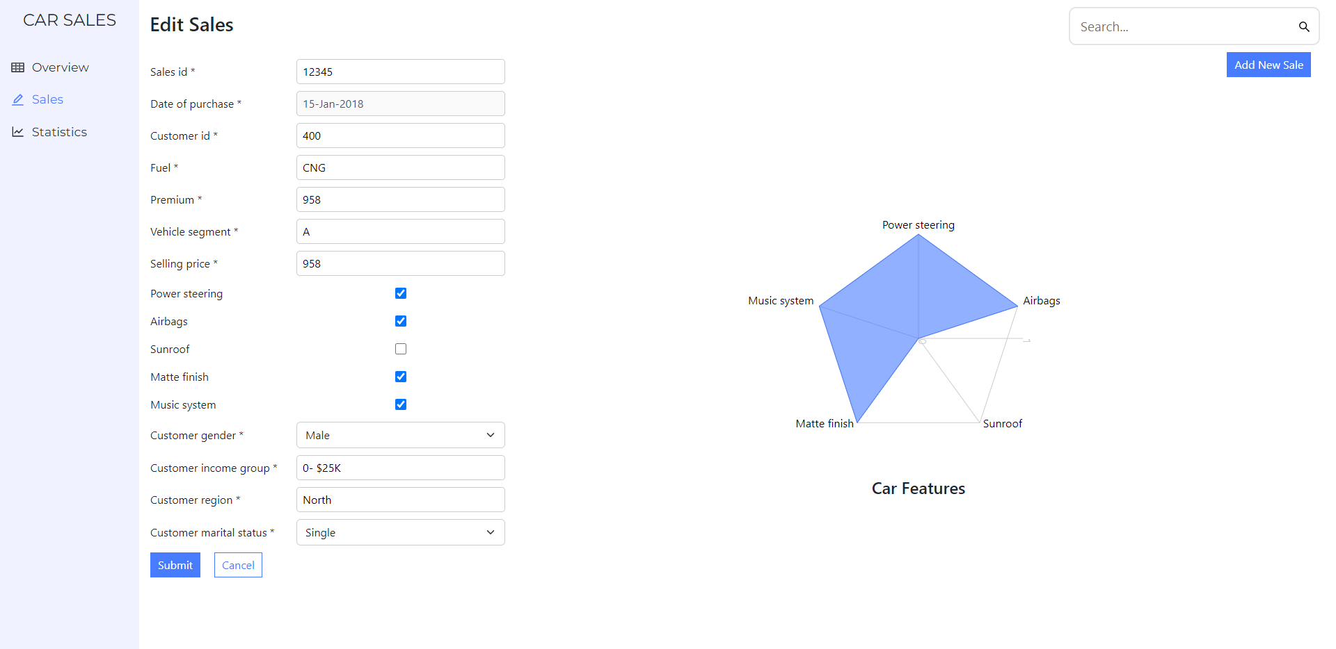

Slide 5
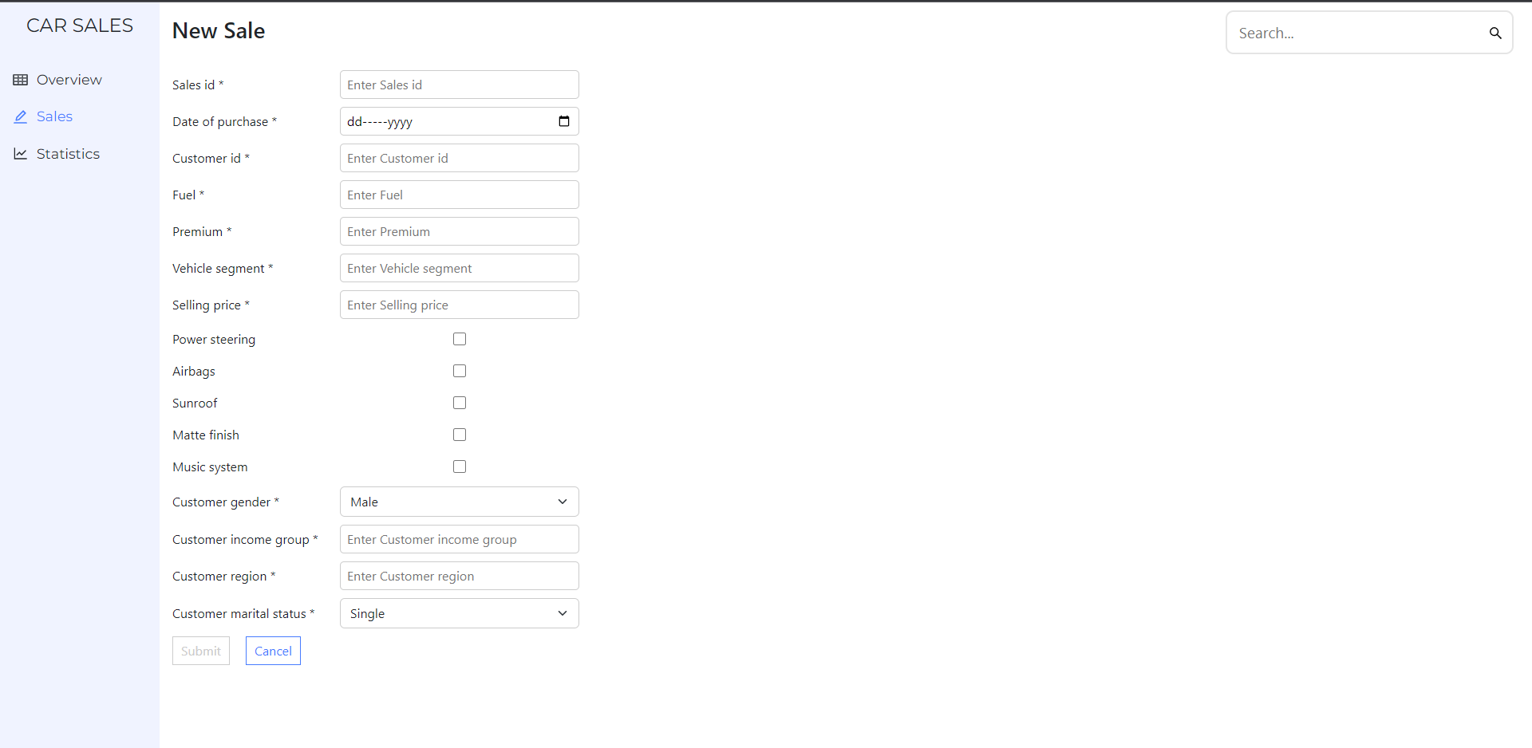

Slide 6
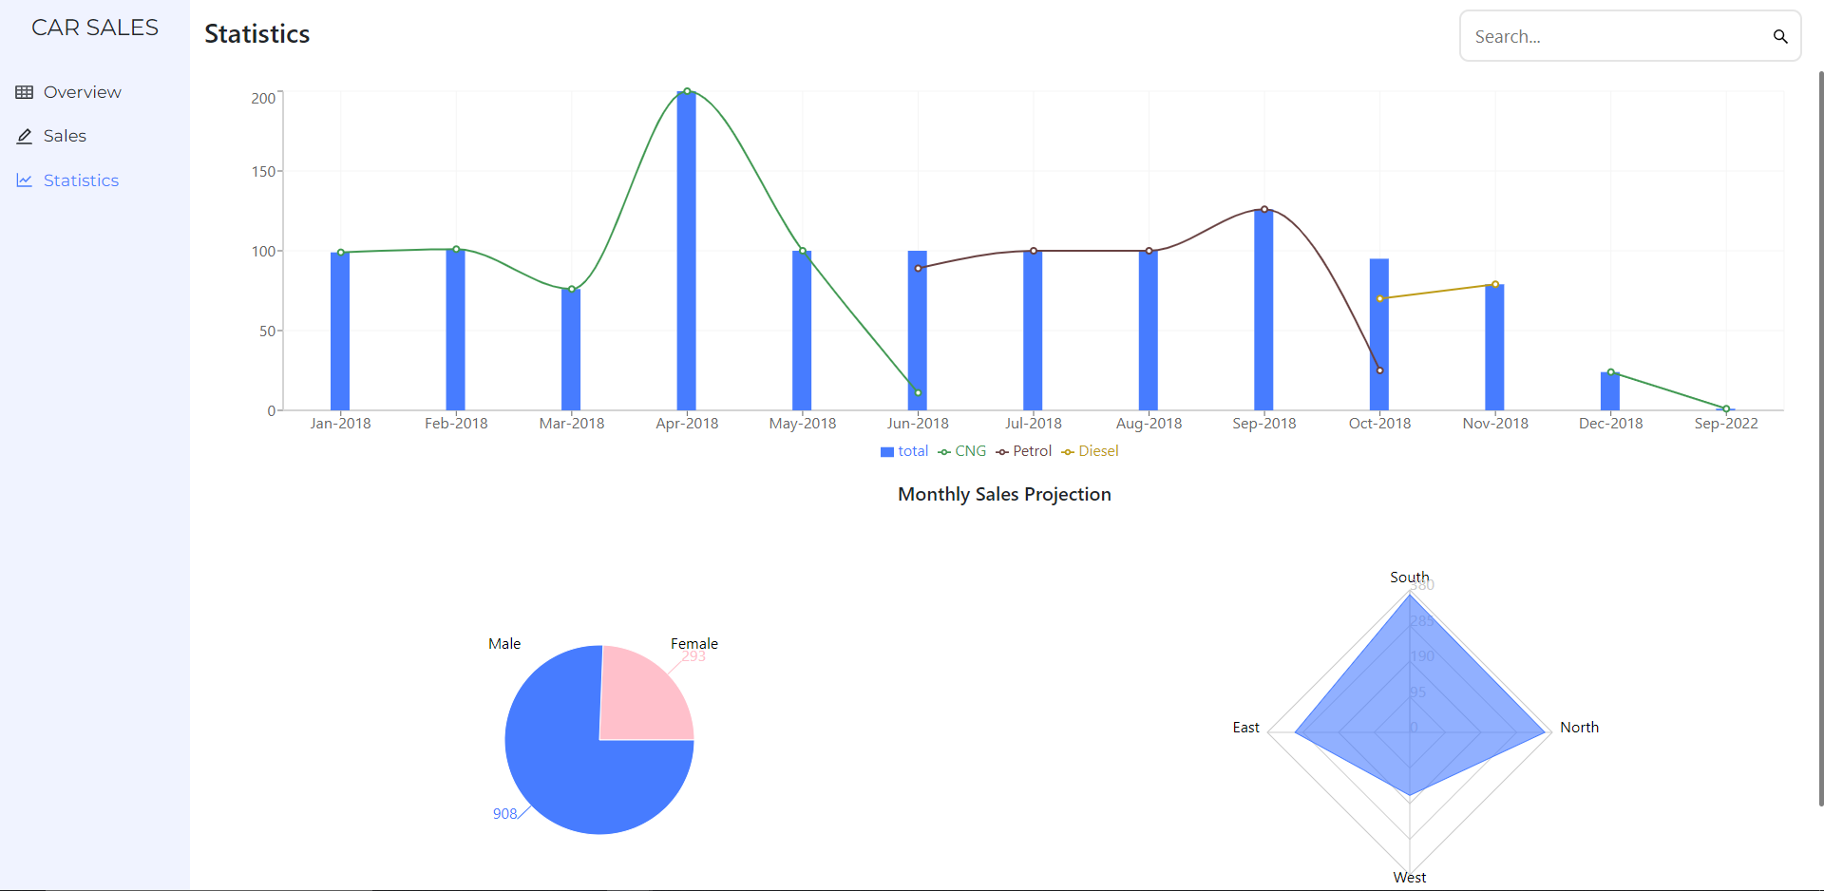

Slide 7
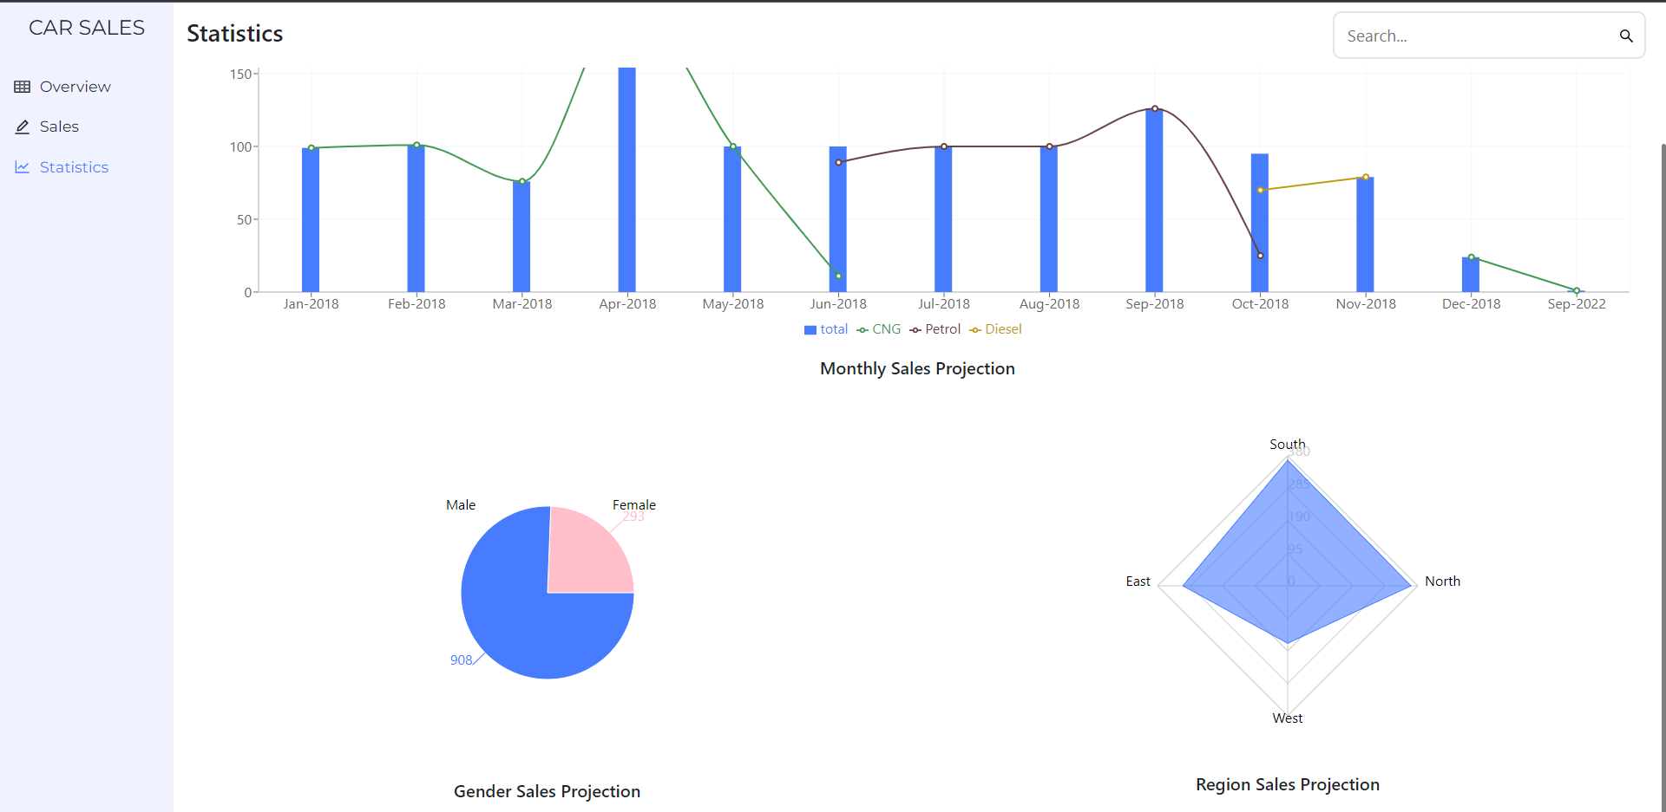

Slide 8
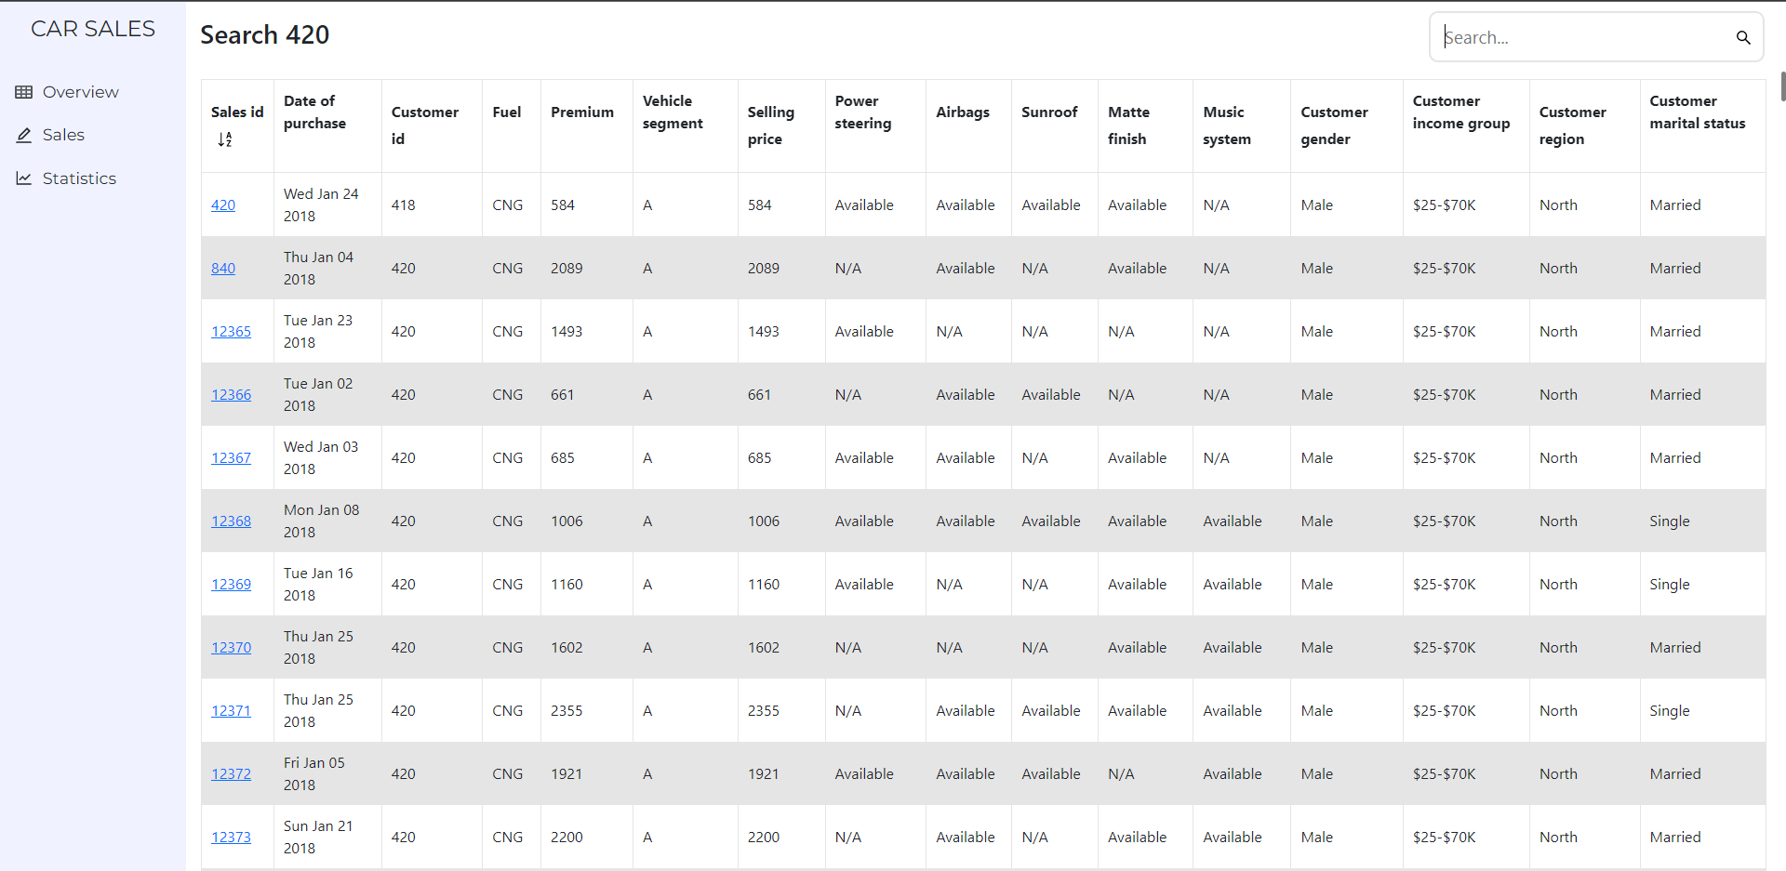

Slide 9
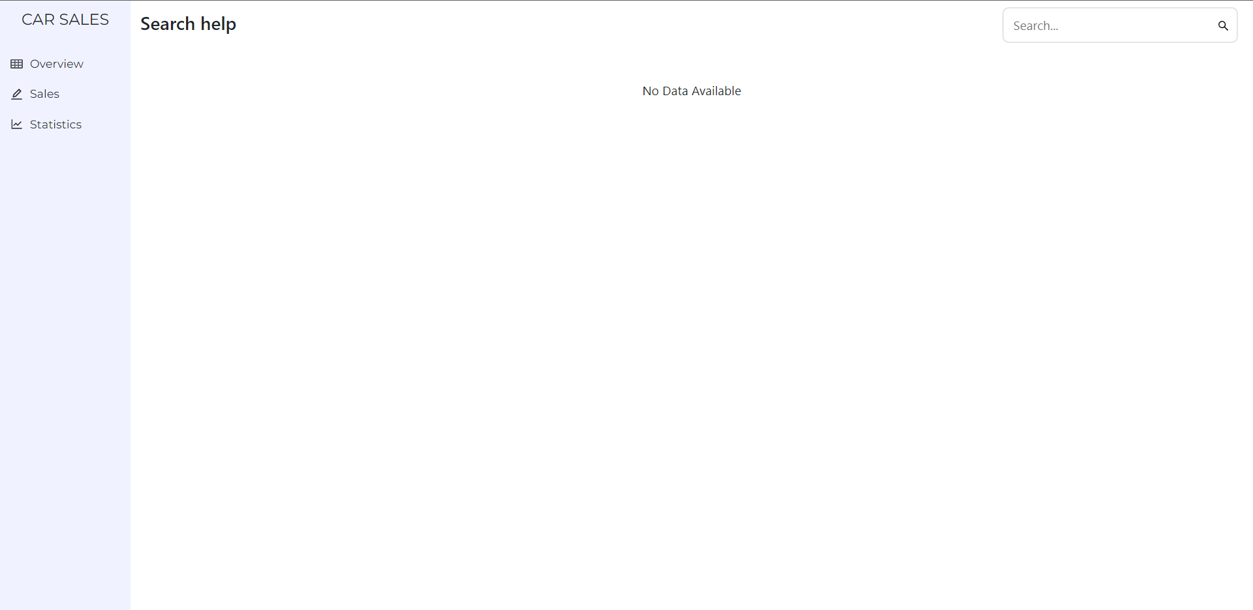

Slide 10
Thank You

